Slide 1
PHARMACY MANAGEMENT SYSTEM

Slide 2
Overview
Vision
Functional Specifications
User Interface Requirements
Database Design
Preferred Software
Hardware Requirements

Slide 3
Vision
The project entitled Pharmacy Management System this is developed for established Medical store in the city. To manage all operations of the medical store this project is being developed. It will have the entire basic module to manage the medical store operations. The main objective of the application is to automate the existing system of manually maintained records of the counter sales, purchases, reorder levels, Supplier and Customer monetary positions and other related transactions made by the seller.
This application can be used by any other store to automate the process of manually maintaining the records related to the subject of maintaining the stock and liquid flows.
The transactions related to purchase, sale and returns are maintained manually at present. These are to be automated and an application is required to relate all of them relatively and logically so that the current system can be replaced and accepted without major changes and problems.

Slide 4
Function Specification
Admin/User enters user id and password for login.
User enters his user id and password for login.
New user gives his completed personnel, address and phone details for registration.
Admin gives different kind of user information for search the user data.
Administrator giving information to generate various kinds of reports.

Slide 5
Problem Identification
The existing system is paper-based involving high amount of paper work and manpower requirement.
Even though computerized systems are used in some places, they are not web-based and are very insecure and improperly managed.
So, the current pharmacy management procedure is very uneconomical and inflexible to meet user demands.

Slide 6
Provide Solution for Problem
The proposed system, being web-based, is very efficient and effective from the point of view of work productivity and time.
It is less tedious to manage operations in a pharmacy with such a system.
It has all the required modules and is developed with the aim of managing staffs, schedule, inventories, and relevant things in the medical store.

Slide 7
Feasibility Report
Preliminary investigation examine project feasibility, the likelihood the system will be useful to the organization. The main objective of the feasibility study is to test the Technical, Operational and Economical feasibility for adding new modules and debugging old running system. All system is feasible if they are unlimited resources and infinite time. There are aspects in the feasibility study portion of the preliminary investigation:
Technical Feasibility
Operational Feasibility
Economical Feasibility

Slide 8
Preferred Technologies
Windows Operating System ( 2000 / XP)
PHP, JavaScript and CSS
MySQL as Back End
Internet explorer 6/7 for Output

Slide 9
Hardware Requirements
Processor : Dual Core
Hard Disk : 40GB
RAM : 256MB

Slide 10
Software Requirement Specification
Operating System : Windows XP/2003 or Linux/Solaris
User Interface : HTML, CSS
Client-side Scripting : JavaScript
Programming Language : PHP
Software : XAMPP
Database : MySQL
Web Server : Apache

Slide 11
Number of Modules
Admin
Login
Pharmacist
Manager
Cashier
Logout

Slide 12
No of Modules
Admin:
Dashboard:
View the main department details Pharmacist, Manager, Cashier.
Pharmacist:
He add the user registration and view user register details. He updated and delete the user details
Manger:
Manager add the user registration and view user register details. He updated and delete the user details
Cashier:
Cashier add the user registration and view user register details. He updated and delete the user details

Slide 13
No of Modules
Pharmacist: These are two sub modules Prescription and Stock
Prescription add the new prescription, view and delete the prescription.
Stock add the medicine. He view and delete the medicine
Cashier:
Cashier maintain the total payment details.
Manager:
Manager have three sub modules they are View users, View Prescription, Manage Stock.
View users: This module view the manager, cashier, pharmacist details.
View prescription: view the Prescription all details.
Manage Stock: add the medicines and view, delete the details.

Slide 14
No of Modules
Login:
The system has a process of login. Whenever a user registration completed then only a user can get log in into the system by using his user id and password.
Logout:
Completed the process then leave the page.

Slide 15
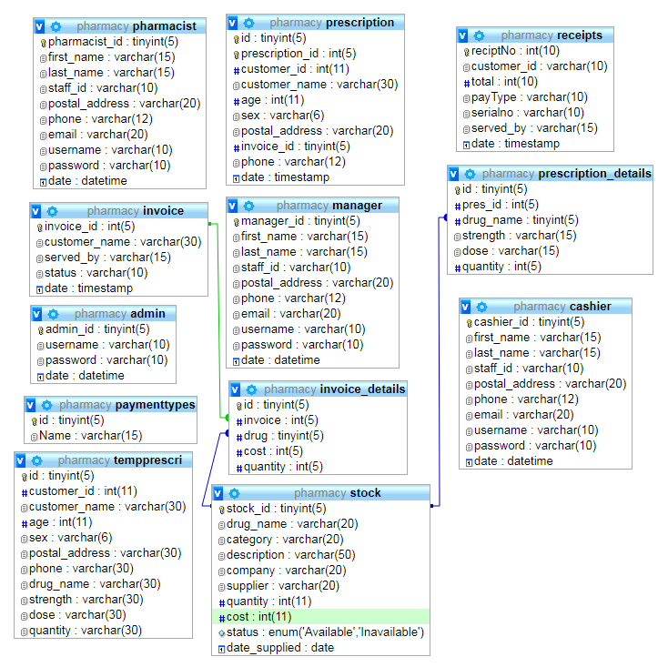
ER-Diagram

Slide 16
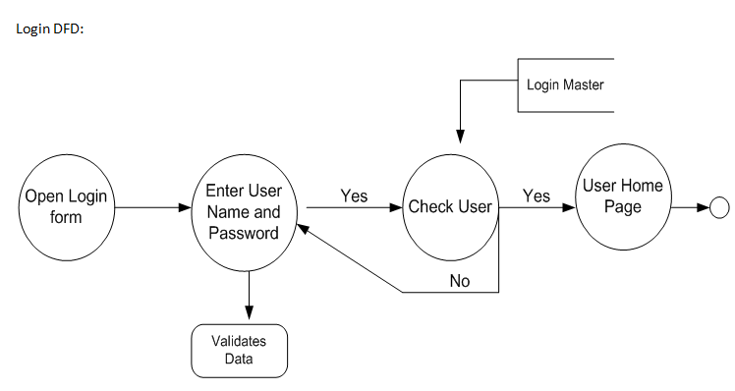
Context or DFD 1st Level

Slide 17
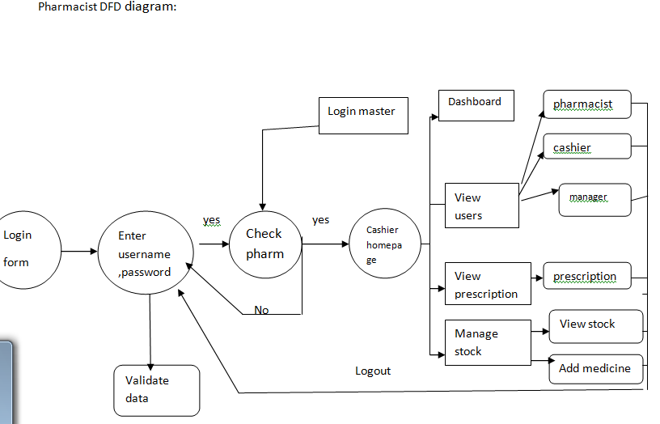
DFD 2nd Level

Slide 18
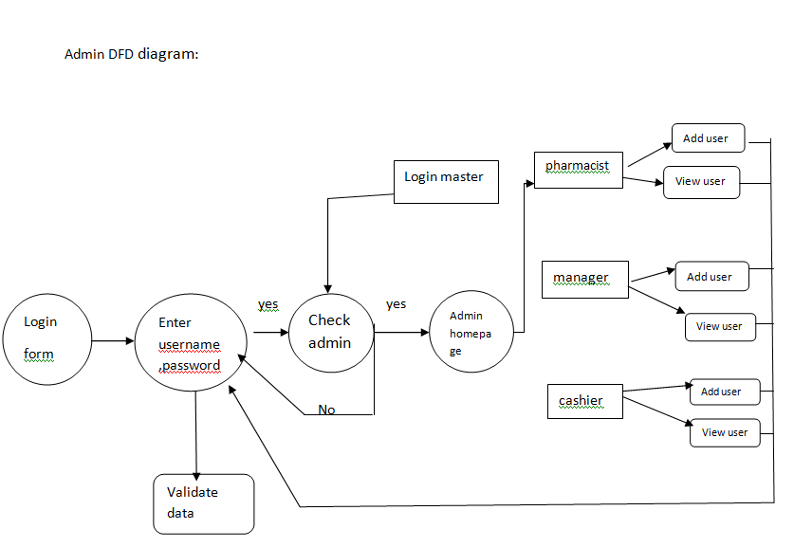
DFD 3rd Level

Slide 19
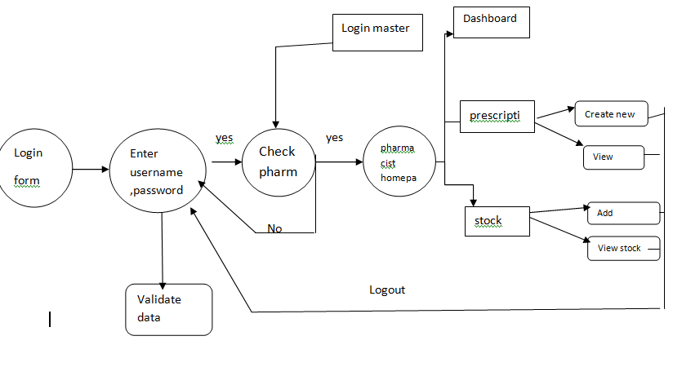
DFD 4th Level

Slide 20
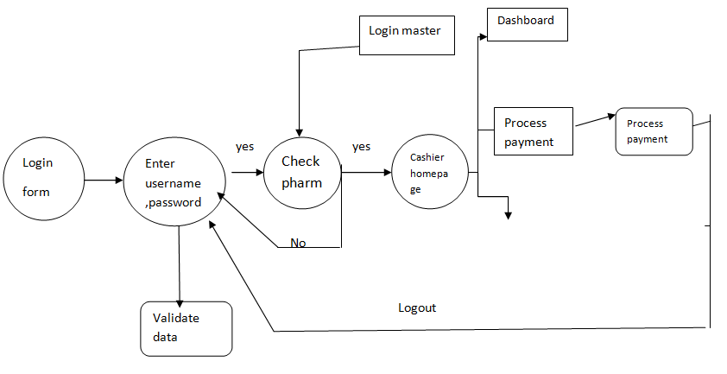
DFD 5th Level

Slide 21
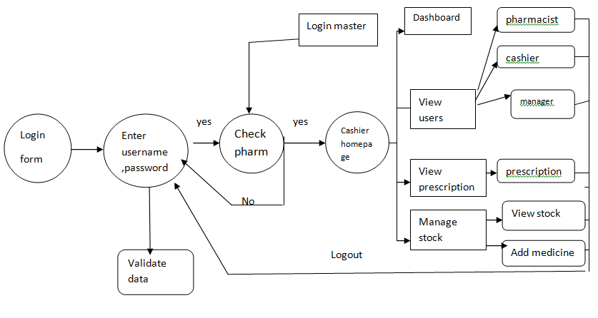
DFD 6th Level

Slide 22
Use case Diagram

Slide 23
Use case 2nd Level

Slide 24
Use case 3rd Level

Slide 25
Use case 4th Level

Slide 26
Use case 5th Level

Slide 27
Sequence Diagram 1st Level

Slide 28
Sequence 2nd Level

Slide 29
Sequence 3rd Level

Slide 30
Sequence 4th Level

Slide 31
Sequence 5th Level

Slide 32
Conclusion
This pharmacy management system can be efficiently used by any medical store to automate the process of data management and maintenance of records related to stock, liquid flows, staffs, customers, and suppliers. New features, modules, and other components can be incorporated into the system as per user requirements in future.

Slide 33
Bibliography
FOR PHP
PHP5 and MySQL by W Jason Gilmore (Apress).
PHP Web Development by Allan Kent and David Powers (Apress).
Professional PHP4 by Christopher Scollo
PHP 5 Unleashed by John M. Coggeshall.
Advanced PHP Programming by George Schlossnagle.
Programming PHP by Kevin Tatroe.
Zend PHP Certification Study Guide by Zend Technologies.

Slide 34
Thank You

